Slide 1
Differentiated Instruction
Meghan Radoicic
EL 5320

Slide 2
Why Differentiated Instruction?
Curious about how this innovation started/began – the shift in education
Wanted to learn more about differentiated instruction in the classroom and the school – how an educational leader would influence this innovation in their school
I implement differentiated instruction in my classroom daily, and it resonates with me because it is something that I am passionate about
Due to the COVID-19 pandemic, there has been a huge learning gap – thus the importance of implementing differentiated instruction in the classroom now more than ever

Slide 3
What is it?
Differentiated instruction is a teaching approach
Instruction is tailored to the students' learning needs
Students learn in all different ways
The learning goal remains the same – the approach to teaching the goal is adapted to the child’s needs to achieve the learning goal
Several ways to teach – small group, one on one, and other ways necessary for the students’ needs/strengths/interests

Slide 5
Data to Support
Several studies were conducted and showed positive outcomes for differentiated instruction in the classroom
“McAdamis (2001) reported significant improvement in the test scores of low-scoring students in the Rockwood School District (Missouri), following the use of differentiated instruction. Apart from this tangible impact of the differentiated model, teachers in this study indicated that their students were more motivated and enthusiastic about learning. This study further reflected the whole-school change which differentiated instruction necessitates – efforts included professional development, mentoring and intensive planning” (Subban, 2006).
“In a study investigating the use of differentiated instruction on student scores on standardized tests, teachers’ perceptions of their ability to meet the needs of diverse students and parents’ expectation of student performance, Hodge, found that students who were prepared for tests using differentiated techniques showed a gain in their mathematics scores” (Subban, 2006).

Slide 6
Data to Support Continued
“Johnsen (2003) conducted a study using undergraduate teachers differentiating instruction to suit different ability levels. Student teachers in this context were encouraged to differentiate content and process, using learning centers, different reading materials and different strategies (Johnsen, 2003). The study revealed that the use of differentiated techniques proved to be engaging, stimulated student interest and providing a gratifying experience for the undergraduate teachers” (Subban, 2006).
“This study revealed that teachers employing higher levels of differentiated techniques experienced increased feelings of self-efficacy and demonstrated greater willingness to try new instructional approaches. It would further appear that differentiated instruction was favored by more experienced teachers who were familiar with the curriculum they taught and who had received extensive training prior to implementing these methods in the classroom” (Subban, 2006).

Slide 7
How Does it Support Students?
Boosts student engagement in the classroom by the teachers making connections to each student and allowing students to choose activities they want to complete that relate to the learning goal – giving choices
Creates more learning opportunities for students especially in elementary grades – more one on one teaching or small group learning instead of whole group instruction
Allows teachers to meet students where they are – modify assignments based on the students’ needs
Implementing different ways of teaching – using manipulatives, visuals, technology – more than just paper and pencil
Students begin to enjoy learning more especially in younger grades (K-5)

Slide 8
How Might it Look in the Elementary Classroom?
Students work in groups that are created based on their academic abilities, interests, or strengths
Teachers get to know each student individually and modify assignments based on each student
Work with small group on their assignments
Students get the same learning goal but they each have a modified assignment
Use a variety of instructional approaches
Alter assignments to meet the needs of the students
Assess students on an ongoing basis to determine their readiness levels
Use assessment results to adjust instruction as needed
Provide a variety of options for how students can learn and demonstrate their knowledge

Slide 9
Limitations
Differentiated Instruction in the classroom can be extremely time consuming
There is a need for intensive curriculum resources – teachers' workload is larger/tougher
Children learn at all different paces, so differentiated instruction may cause some groups of students to spend more time on certain academic areas
There can be a lack of a schedule or creating a schedule becomes more difficult

Slide 10
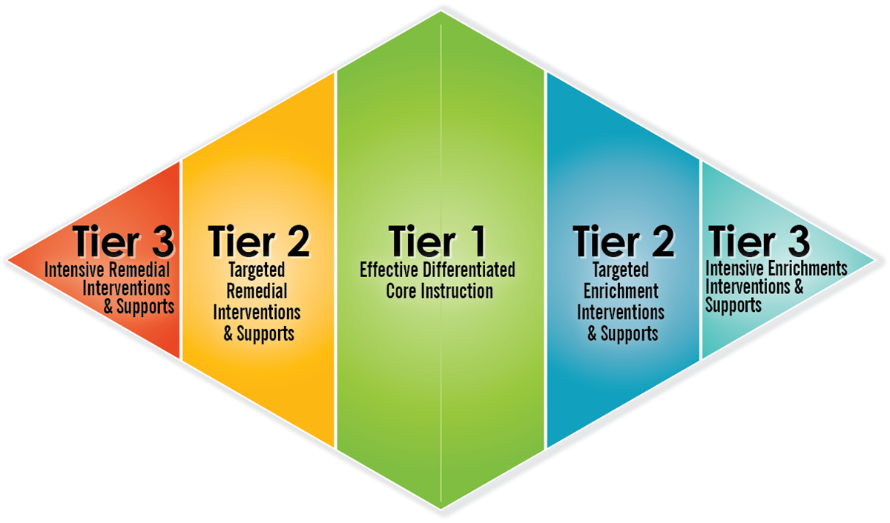
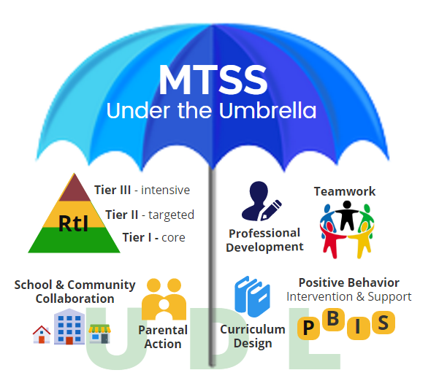
Educational Leader
An educational leader can implement differentiated instruction throughout their building using a program like Multi-Tiered System of Supports. (MTSS)

Slide 11
My New Understandings
Differentiated Instruction can be a controversial topic for teachers, and as a future educational leader, if I want the school to implement differentiated instruction then I need to provide the supports, professional development, time,. and resources that they would need to successfully implement it
Differentiated Instruction can look different in all types of classrooms
Most studies show that students are more engaged in learning when differentiated instruction is being implemented
Many teachers who have been in the profession for years favor differentiated instruction more than new teachers due to the deep understanding of the curriculum and learning goals

Slide 12
Video

Slide 13
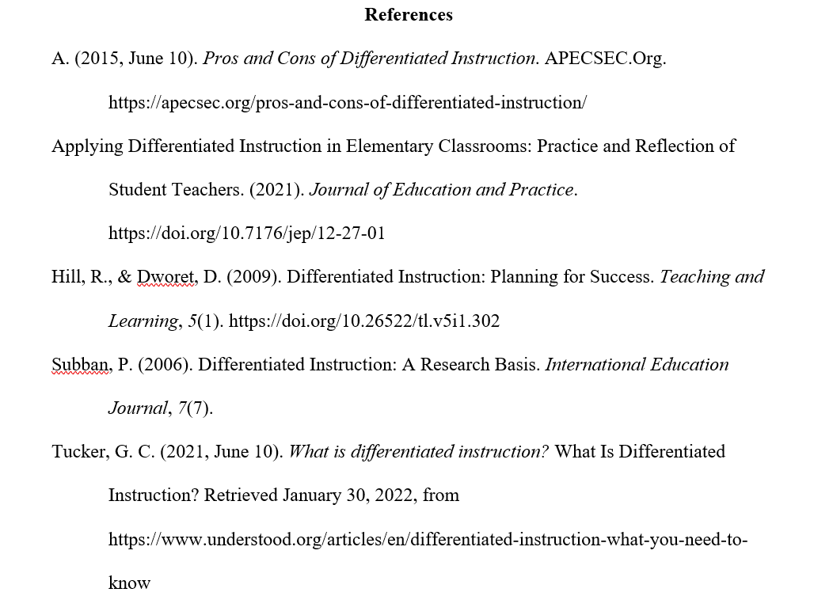
Resources

